Slide 1
Capstone Project
AirBnb Booking Analysis
Shivam Bhardwaj

Slide 2
Points for discussion
Problem Statement
Data Summary
Insights
Advice and Suggestions
Conclusion

Slide 3
Problem Statement
AirBnb is a hotel and room rental service provider. We have been provided with the dataset of the business from the city of New York and it looks like the dataset is of 2019. The dataset has information on the users, the hosts and the listings.
Using the dataset, we can provide insights that helps the businesses in many ways. We can provide marketing guidelines and also help the stakeholders understand the behaviour of users and the hosts, thus helping them drive the business.

Slide 4
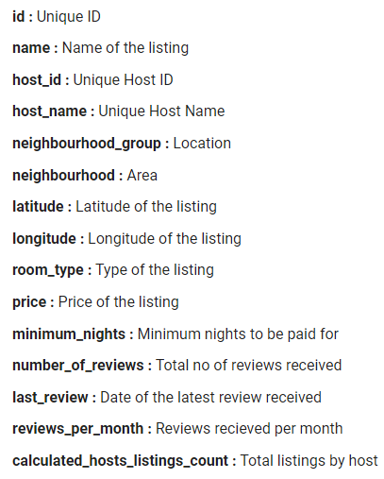
Data summary
The dataset is from the hotel and apartment rental booking site AirBnb. We have to use whatever we can from the dataset and provide insights on the user and the hosts' behaviour. These insights can then be used to make marketing strategies or other important decisions to increase the revenue or decrease the loss, if there is any.
We will focus mainly on the user behaviour side to try and understand what drives a consumer to leave a review and what doesn't. We may also look at anything we can to learn about the hosts.
The dataset has 48895 records and 16 columns. There are no duplicate values, but there are values missing in four of the 16 columns.

Slide 5
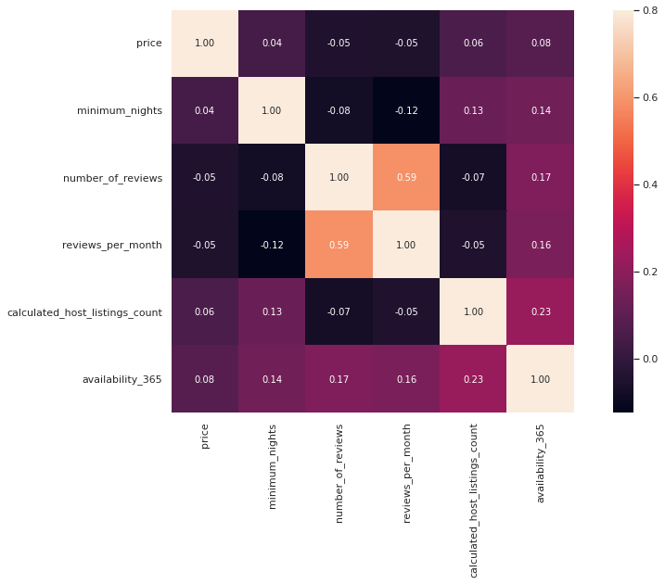
Are any two variables linearly related?
From the overlook, there seems to be no relationship between any two variables of the dataset except for the very obvious one (number of reviews and reviews per month).

Slide 6
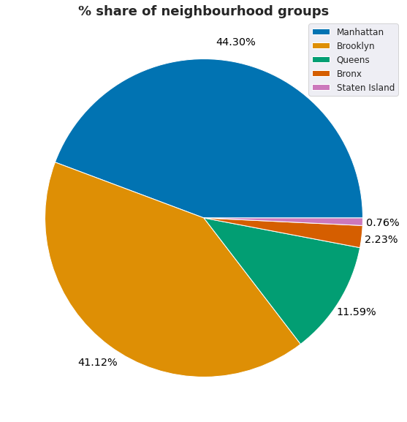
What is the % share of the neighbourhood groups in our dataset?
We can see that the dataset comprises of listings from mainly three neighbourhood groups.
Manhattan and Brooklyn comprise almost 85% of the listings of New York on AirBnb. Whereas Bronx and Staten Island (the largest of the five neighbourhood groups) lack presence and account for only about 3% combined.
It helps a company to know where its user base is from and where it is not doing well. When the largest neighbourhood group in terms of area of the five has the lowest number of listings, AirBnb needs to acquire most listings from over there.
Any Advice/Suggestion: Increase foothold in Staten Island and Bronx.

Slide 7
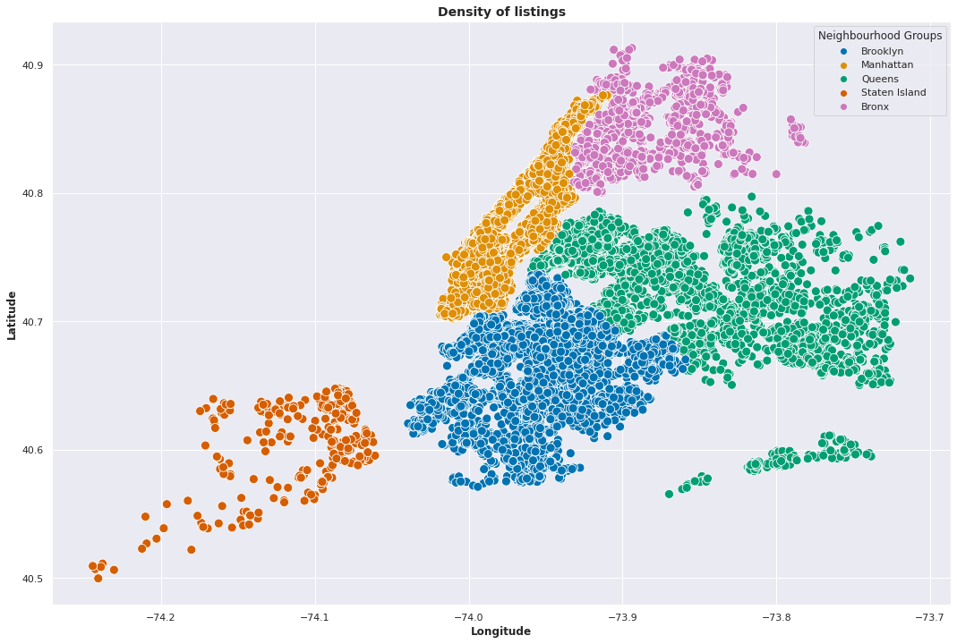
What is the density of listings in the neighbourhood groups?
Staten Island has the least density of the listings whereas places like Manhattan and Brooklyn are densely populated.
We know that the places in Manhattan and near it have the highest density of listings. That seems to be the most popular areas thus for users.

Slide 8
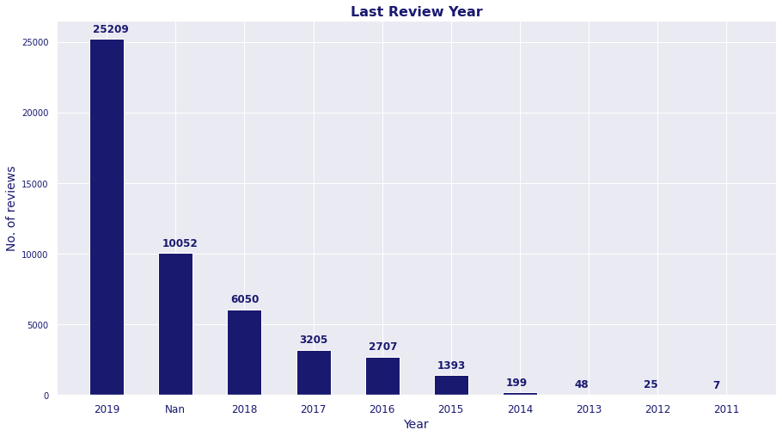
Distribution of the listings based on when they received their last review:
We see that 10052 i.e. 20.5% of the listings are yet to receive a review and that 25209 i.e. only 51.55% of the listings have received a review in the year 2019, the supposed year of the dataset.
From the given dataset, reviews are perhaps the most obvious way of defining user behaviour. And anyway, a business like AirBnb will always need feedbacks on the listings from the consumers.
So, reviews are key and only about half of the listings getting reviews is very low. Users should be incentivized in some manner to leave reviews and feedbacks to help the service provider maintain the standards.
Any Advice/Suggestion: Incentivize users to review listings.

Slide 9
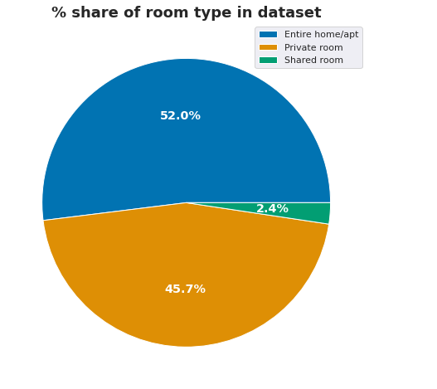
What is the % share of room types in our dataset?
The most common type of rooms available are apartments that are fully available on rent. These account for 52.0% of the listings.
The next most common type of listings is the private room type. Here, a room from an apartment or a home is available for use to an individual. This kind of rooms account for 45.7% of the listings.
Shared rooms are available as well and account for 2.4% of the data.
Any Advice/Suggestion: Investigate and if needed incentivize hosting shared rooms.

Slide 10
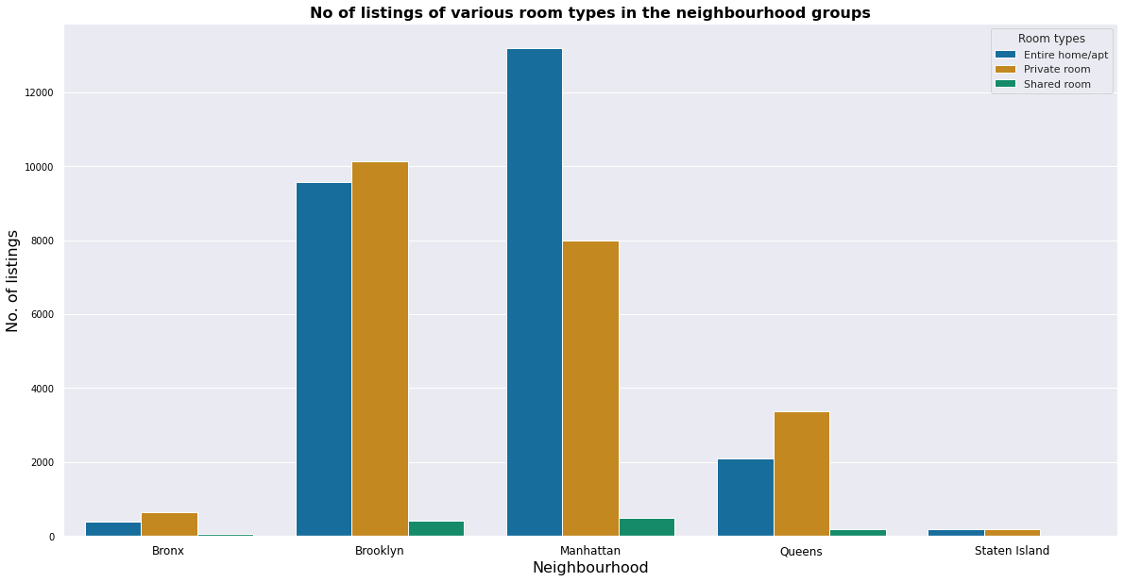
What is the % share of room types in the neighbourhood groups?
Apart from Manhattan, the rest of the neighbourhood groups have more private room listings than entire room/apartment listings.
It gives us an idea of what the users want and what the hosts provide. The most interesting point for the stakeholders should be looking into what makes the users get entire apartments rather than a private room even though the former are much more expensive.
Any Advice/Suggestions: Try to get data to understand what makes users prefer entire home/apt over private rooms, unlike other neighbourhood groups.

Slide 11
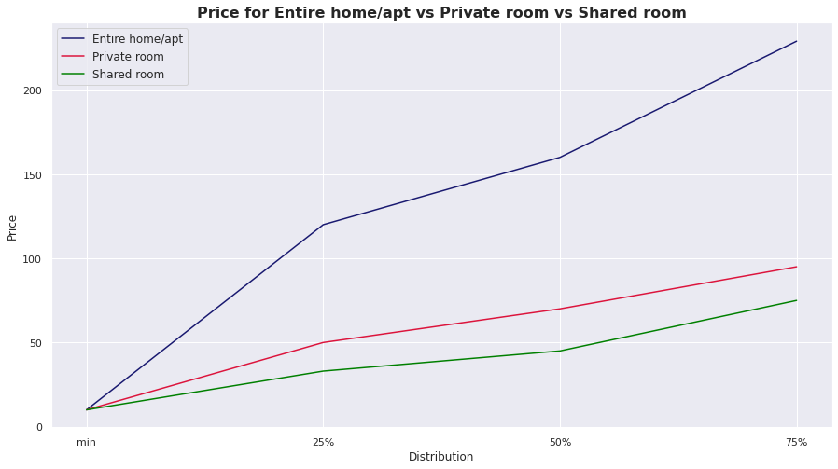
What are the range of prices for the three room types?
All the three have the cheapest options starting from $10. However, the rise in the price for an entire home or apartment is very considerable. Whereas, there is very little difference between the prices of the other two types, even as we move towards the higher end of the pay.
More than 75% of the rooms for the private and shared ones cost lesser than $100 whereas the price doubles at the 75th percentile for entire rooms and apartments option when compared with the other two.

Slide 12
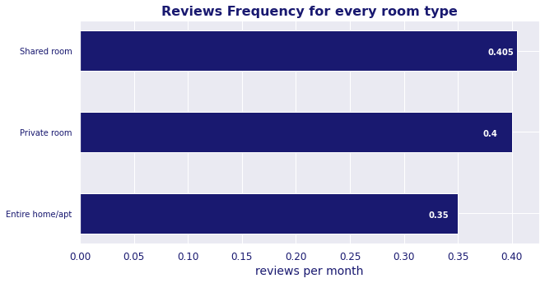
Which type of room gets most reviews on average?
We can see that the shared rooms get reviews more frequently than the two more expensive types.
Actually, private rooms are reviewed almost as frequently as the shared rooms.
The cheaper rooms will always have the biggest crowd if they have all the basic necessities made available. This betters the user experience and since the users already review such rooms more frequently, there will be more positive feedbacks for the listings and thus AirBnb.

Slide 13
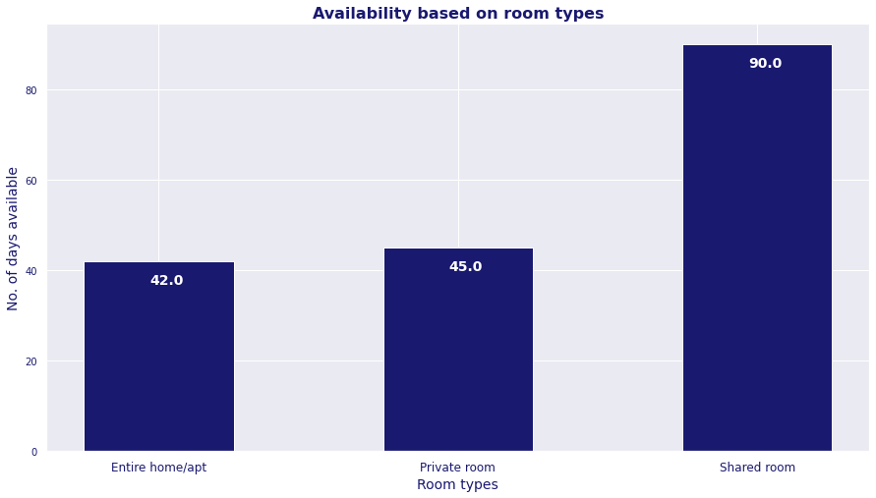
Which type of room is available the most based on median?
Shared rooms are more available (90 days) whereas entire homes or apartments and private rooms have almost similar availability (42-45 days).
Marketing campaigns to create awareness about the easy availability and easy affordability can be created to inform the consumers about the shared rooms where we have already established the fact that there is a big room for growth.
Any Advice/Suggestion: Marketing campaigns to create awareness about affordability and availability of shared rooms

Slide 14
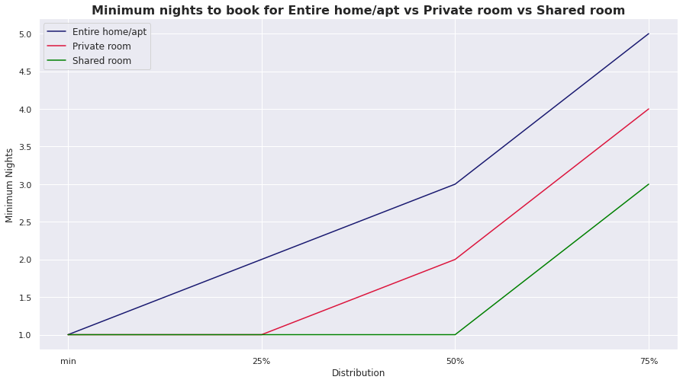
What is the distribution of minimum nights booking for the different types of rooms?
More than half of the shared room listings can be booked just for a day and then the other half see the growth in the number of minimum days of bookings required at the same rate as the other two room types.
Entire Rooms have consistent growth and are expected to be booked usually for days than the other two room types.
And the private rooms see almost similar growth as entire rooms in the later 75 percentile of listings before seeing none in the first quantile.

Slide 15
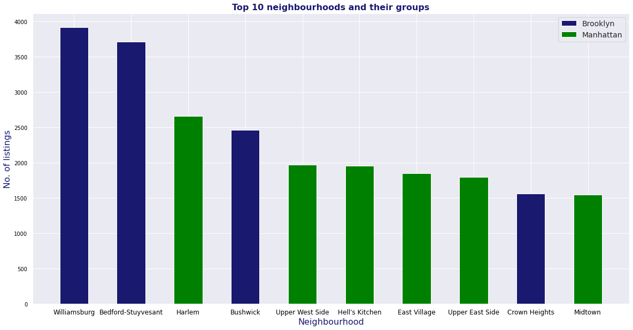
Which are the top 10 neighbourhoods of New York in terms of number of listings?
The top 10 listings are from the two most popular neighbourhood groups, Brooklyn and Manhattan.
And surprisingly, they account for 47.95% of the total listings

Slide 16
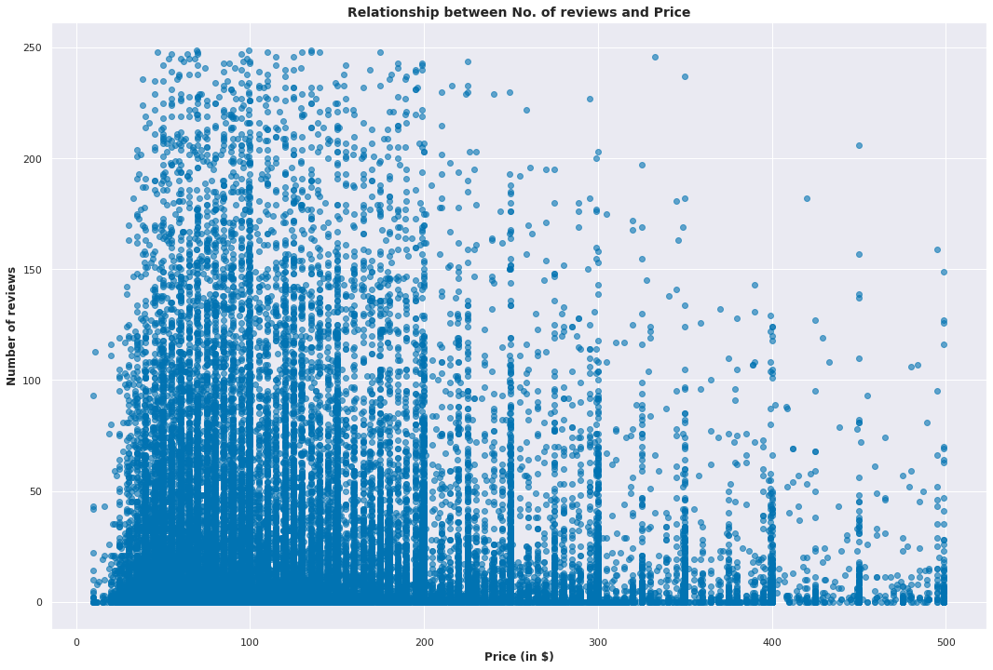
How does the price vary with the number of reviews per month?
It is easy to tell by looking at the graph that there is no relation between the price and the number of reviews of a listing.
The chart ensures that there will be no idea of a relationship between the price and the number of reviews a listing receives in the minds of the decision makers.
More luxurious rooms don't mean the place is going to be reviewed more oftenly. Or that more affordable listings will get more feedbacks. The price doesn't have a say in the user's motive to review a place.

Slide 17
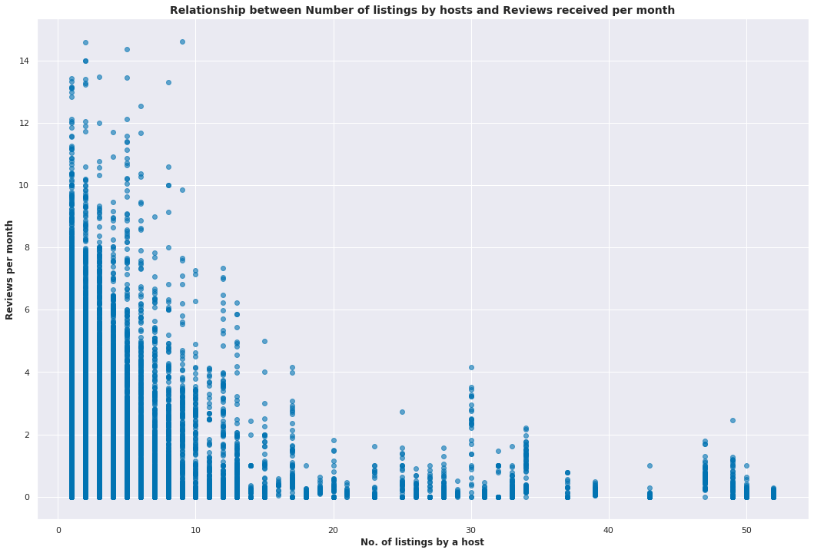
What is the relationship between number of listings by a host and reviews received per month?
There is no relationship between the total number of listings by a host and the number of reviews his listing gets every month on average.
It tells that the hosts with more listings are not doing anything differently to drive the number of reviews their listings are getting. However, getting reviewed frequently and positively helps hosts build trust and acquire more users.

Slide 18
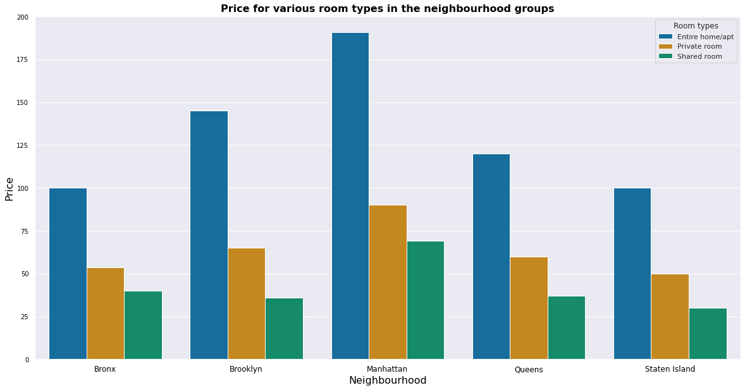
What are the median prices for various room types in all neighbourhood groups?
Manhattan is the most expensive neighbourhood group whereas Bronx and Staten Island have almost similar costs and are the cheapest.
Manhattan is so expensive that getting a private room there is as expensive as getting an entire home/apt in Staten Island and Bronx.
The price of getting a private room is almost same for all the neighbourhood groups but Manhattan.

Slide 19
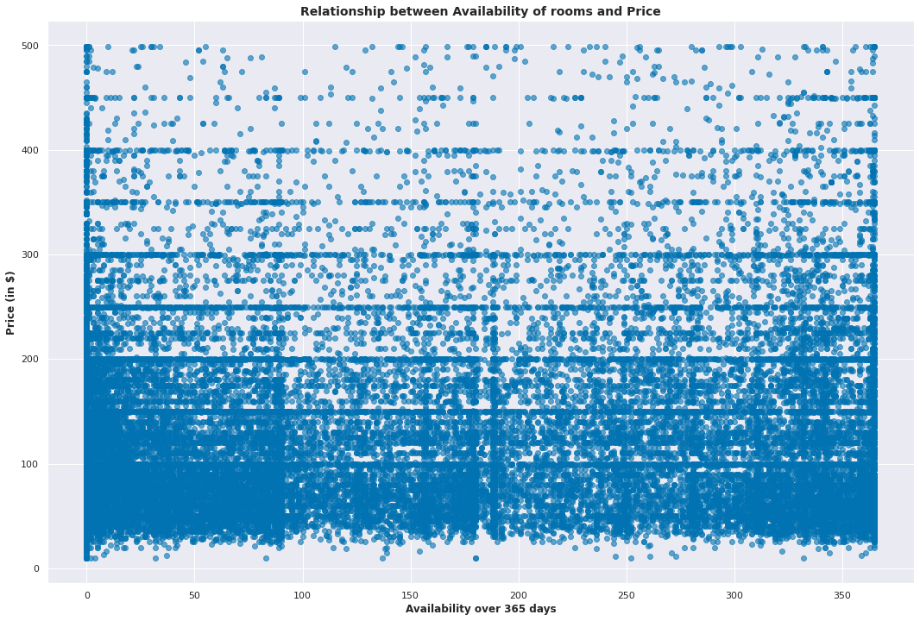
What is the relationship between availability of rooms and their price?
We can tell that price does not decide whether a listing will be popular among the users or not. It may be one of the reasons but not the only. And, of course, there are going to be exceptions given how hosts may offer promotional discounts.

Slide 20
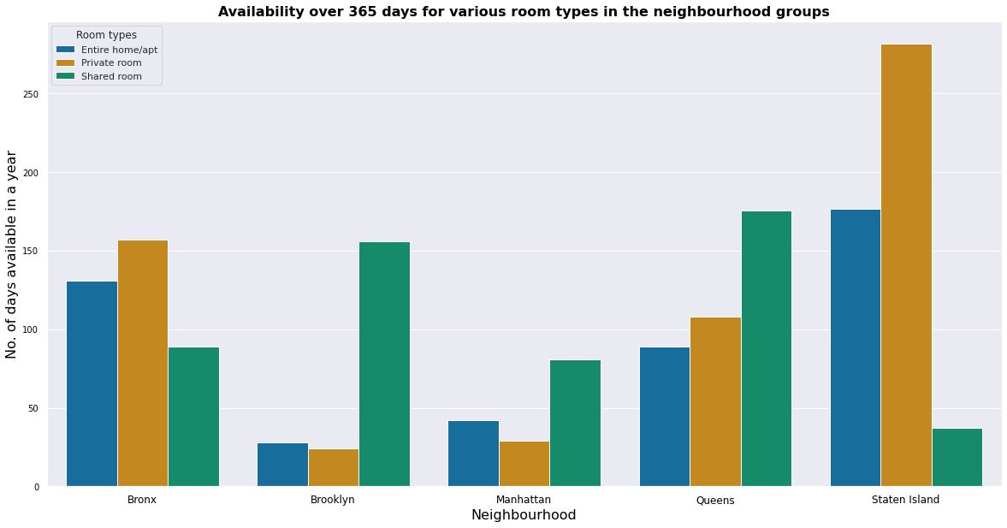
How does the availability of the different room types vary in the neighbourhood groups?
Private rooms and entire home/apt are available for lesser than 50 days on average in Brooklyn and Manhattan. Which means the places with more listings prefer entire rooms or a private room over shared rooms.
Shared rooms are the busiest of all the room types in Staten Island and have some of the lowest availability rate in New York.

Slide 21
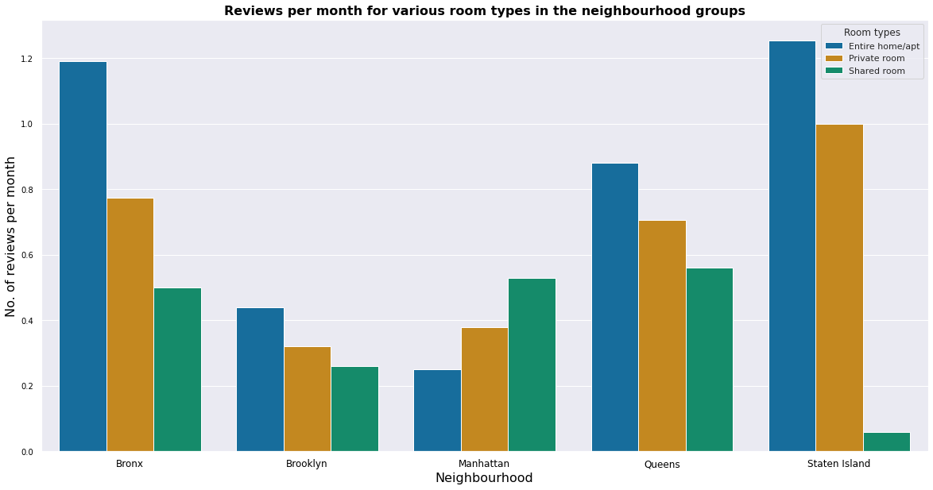
How does the review frequency vary for room types in the neighbourhood groups?
Manhattan has users writing reviews for the shared and private rooms more than entire rooms, a trend not common with the other neighbourhood groups.
Staten Islands has the highest reviews rate (for entire room/apt) and the lowest reviews rate (for shared rooms) of all the data we have for the listings in the five neighbourhood groups.
Even though there's very little difference between the number of entire room and private room listings, there is a considerable difference in the number of reviews the two get for the neighbourhood groups.
Any Advice/Suggestion: More data should be collected and analysed to understand what are driving the reviews and if they are positive or not.

Slide 22
Advices and Suggestions:
From our EDA, we have the following advices/suggestions for the stakeholders:
Increase foothold in Staten Island and Bronx.
Try to get data to understand what makes users in Manhattan prefer entire home/apt over private rooms despite the vast difference in price.
Incentivize users to review listings.
Investigate and if needed incentivize hosting shared rooms.
Marketing campaigns to create awareness about affordability and availability of shared rooms.
More data should be collected and analysed to understand what are driving the reviews and if they are positive or not.

Slide 23
Conclusion:
Manhattan and the places nearby are densely populated. It is the most popular neighbourhood.
Manhattan and Brooklyn comprise almost 85% of the listings of New York on AirBnb. Whereas Bronx and Staten Island (the largest of the five neighbourhood groups) lack presence and account for only about 3% combined.
The most common types of rooms are apartments or homes fully available whereas the least common type is the shared room.
More than 75% of the rooms for the private and shared ones cost lesser than $100 whereas the price doubles at the 75th percentile for entire rooms and apartments.
There are more listings of entire home/apt in Manhattan than private rooms, a trend uncommon among the other neighbourhood groups.
Generally, shared and private rooms are reviewed more frequently than entire house/apt room type.
Shared rooms are more available (90 days) whereas entire homes or apartments and private rooms have almost similar availability (42-45 days).
Booking entire home/apartment doesn't only need more money but a commitment of more days as well.
There is no relation between the price and the number of reviews of a listing.
Manhattan is so expensive that getting a private room there is as expensive as getting an entire home/apt in Staten Island and Bronx.
The price of getting a private room is almost same for all the neighbourhood groups but Manhattan.
Price does not decide whether a listing will be popular among the users or not.
Private rooms and entire home/apt are available for lesser than 50 days on average in Brooklyn and Manhattan.
Manhattan has users writing reviews for the shared and private rooms more than entire rooms, a trend not common with the other neighbourhood groups.

Slide 24
Thank You

